Slide 1

Predicting the Impact of the Next Recession with Financial Indicators
Yeswanth Reddy Chereddy
Afzal Mohammad
Yugala Kakarla

Slide 2

Introduction
Financial data science combines quantitative finance with data analytics to forecast market trends and economic conditions, providing valuable insights for strategic decision-making.
Our goal is to predict the potential effects of the next recession by analyzing changes in key financial indicators, which are often kye predictors to economic shifts.
We utilize ARIMA models, a cornerstone in time series analysis, to project the future values of these indicators over the next year of business days.
We focus on four pivotal metrics: the 10-Year Real Interest Rate, Real Estate Loans, Sticky Price CPI, Bank Credit and Unemployment Rate, each a bellwether of economic health.

Slide 3
Data Sourcing and Preprocessing for ARIMA Modeling
We have sourced comprehensive datasets from Kaggle: https://www.kaggle.com/datasets/mikoajfish99/us-recession-and-financial-indicators/codeto
10-Year Real Interest Real Estate
Loans All Commercial Banks
Sticky Price Consumer Price Index less Food and Energy
Unemployment Rate and Bank Credit
Ensuring data quality is paramount. We meticulously cleaned the data, addressing any anomalies and ensuring consistency across all datasets.
To facilitate accurate ARIMA modeling, we normalized the data, standardizing scales and smoothing volatility without compromising the temporal patterns crucial for forecasting.
Our preprocess financial data function played a key role in preparing the data, transforming raw figures into a format optimized for time series analysis.

Slide 4

ARIMA Model
The statistical method known for its ability to forecast and comprehend time series data, which encapsulates autoregressive, integrated, and moving average components, is the foundation of our project: the ARIMA model.
Each financial indicator was modeled using an ARIMA configuration of order=(1, 1, 1), indicating the model includes one autoregressive term, one difference, and one moving average term.
The model forecasts the next 252 business days, providing insights into future trends of the financial indicators.
By converting unprocessed data into an easily accessible roadmap, this method enables stakeholders to plan ahead and strategically address future economic ups and downs.

Slide 5
Measuring Forecast Accuracy with Evaluation Metrics
To measure the precision of our forecasts, we employ two critical metrics: Mean Absolute Error (MAE) and Root Mean Squared Error (RMSE), each providing unique insights into our model's performance.
MAE captures the average magnitude of errors in our predictions, offering a clear and straightforward perspective on forecast accuracy without considering the direction of the errors.
RMSE gauges the square root of the average squared differences between predicted and actual values, heavily penalizing larger errors, thus reflecting both the variance and bias of the predictions.
Lower values of MAE and RMSE are indicative of more accurate forecasts. These metrics serve as our north star, guiding model refinement and ensuring the reliability of our economic insights.

Slide 6
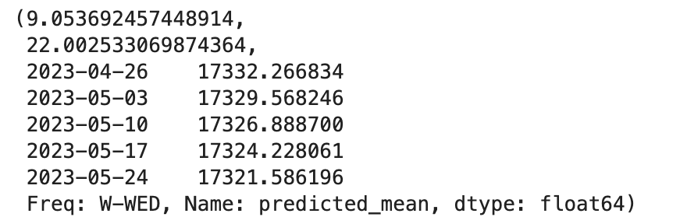
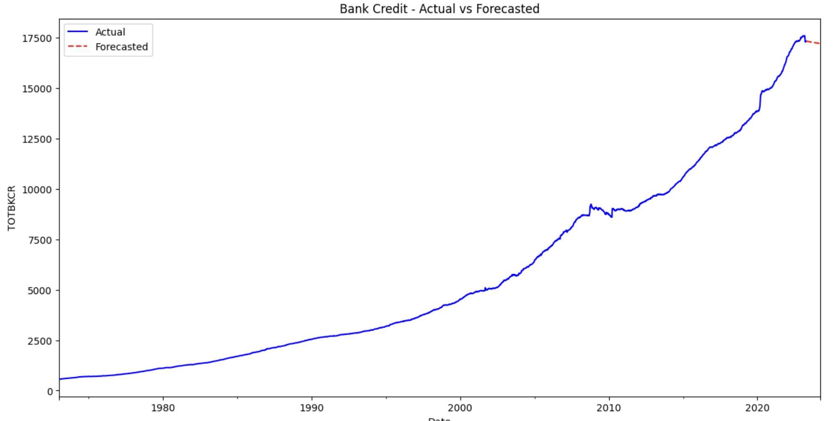
Bank Credit
MAE AND RMSE

Slide 7
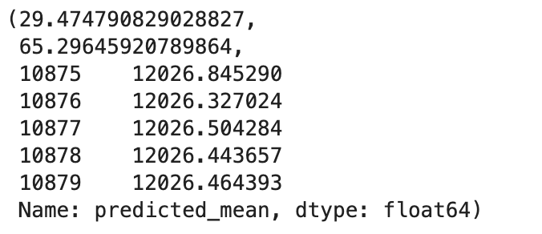
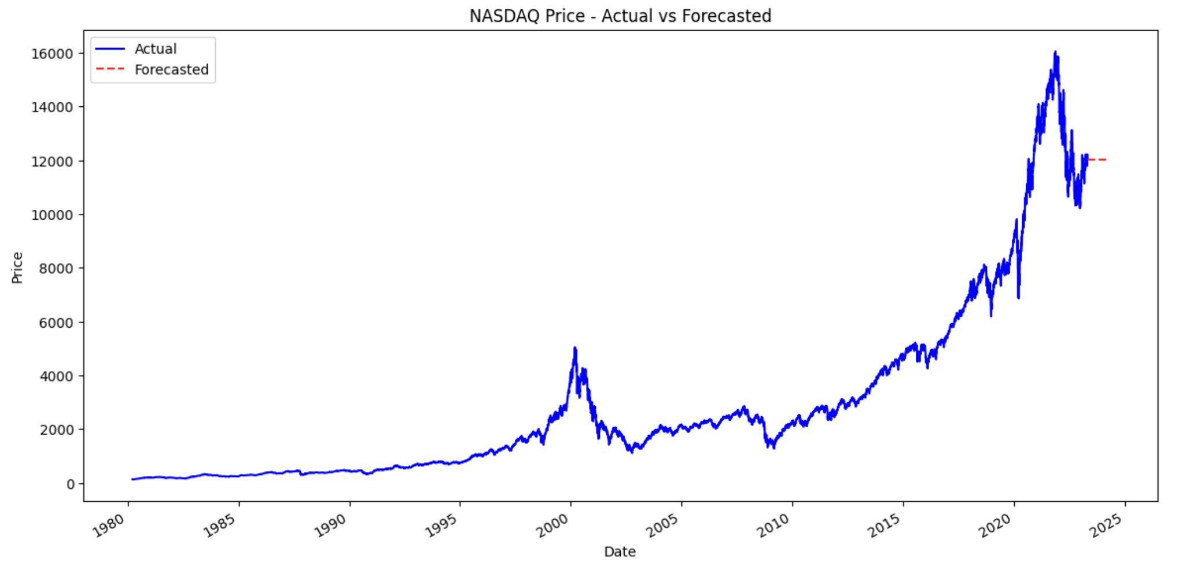
NASDAQ
MAE AND RMSE

Slide 8
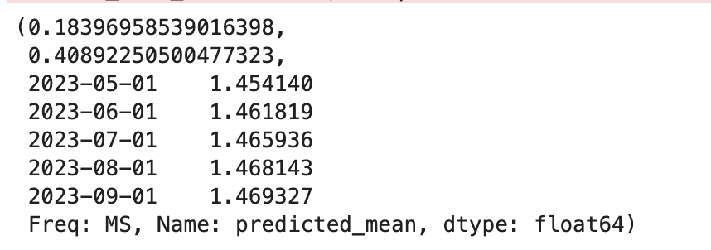
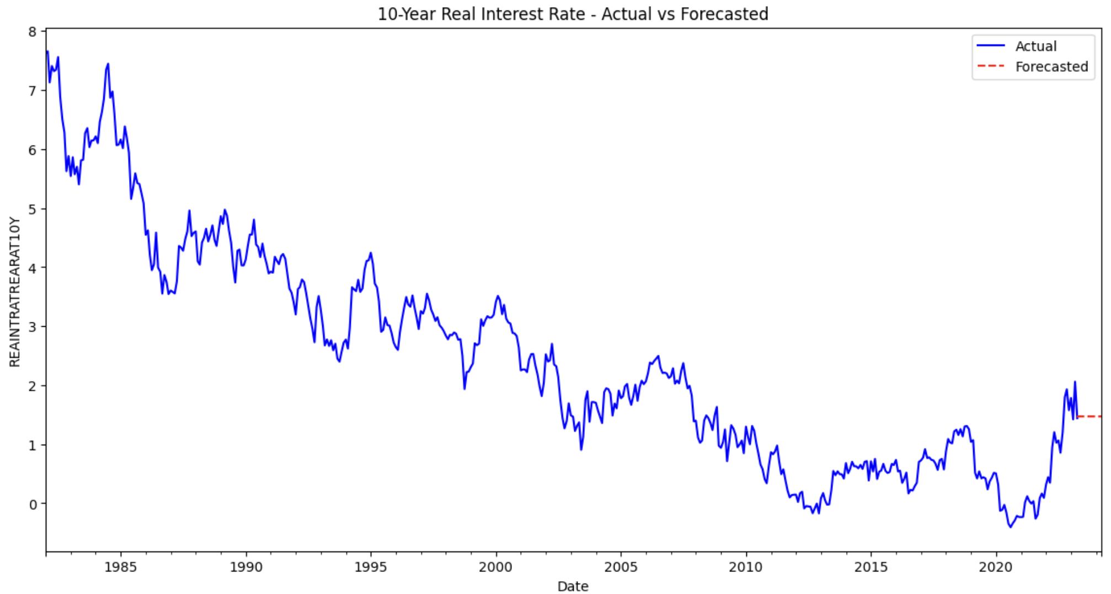
10-Year Real Interest Rate
MAE AND RMSE

Slide 9
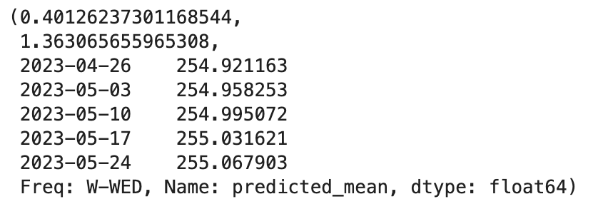
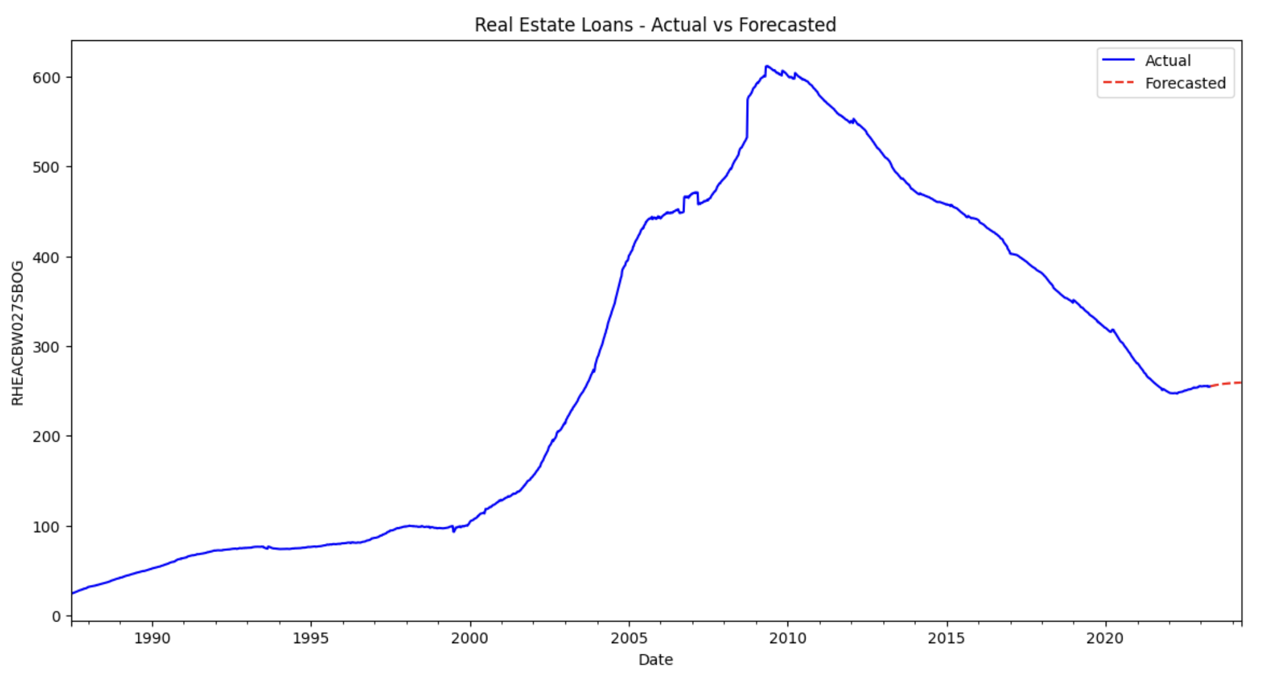
Real Estate Loans
MAE AND RMSE

Slide 10
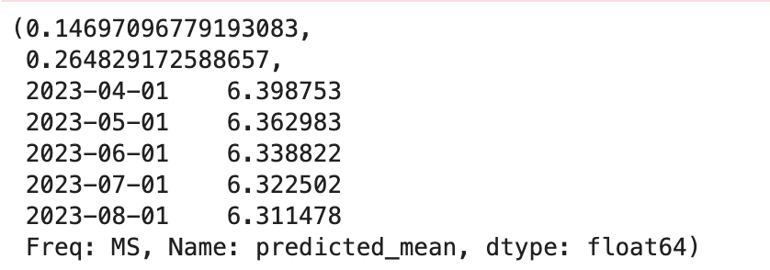
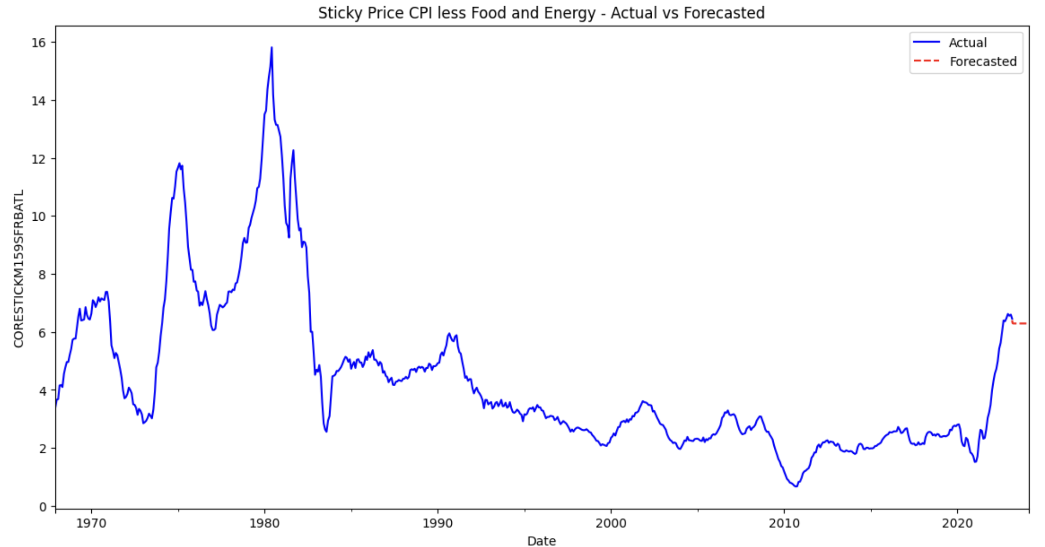
Sticky Price CPI
MAE AND RMSE

Slide 11
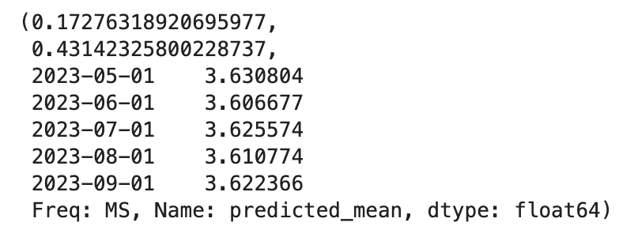
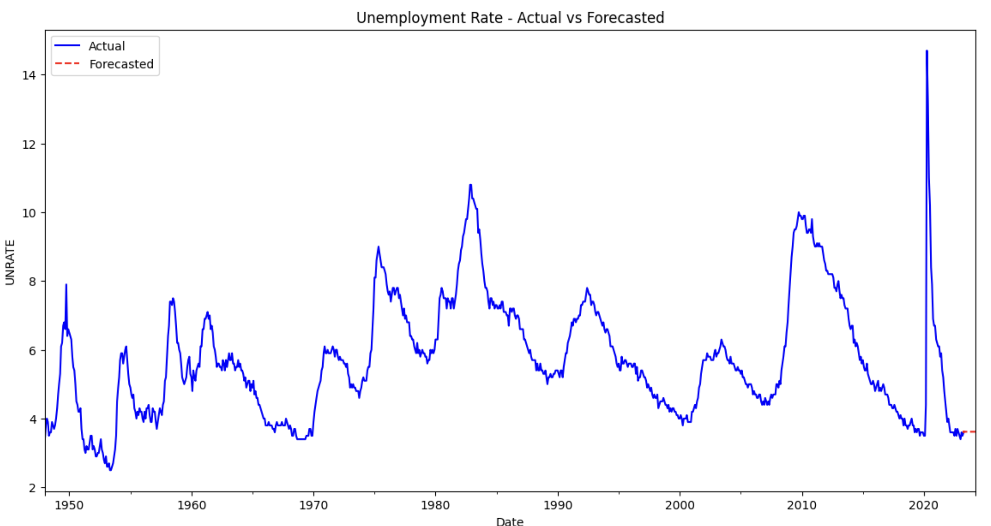
Unemployment Rate
MAE AND RMSE

Slide 12

Impact of a Hypothetical Mild Recession on Financial Indicators
Noticeable decrease in values for NASDAQ and SPX500, indicating a downturn in market conditions.
An increase in the 10-Year Real Interest Rate, suggesting a tightening of monetary policy or an increase in risk aversion among investors.
A slight decrease in Real Estate Loans, which could reflect a downturn in the housing market or tighter lending standards.
Minimal changes in the Sticky Price CPI, possibly illustrating the rigidity of consumer prices against short-term economic fluctuations.
An increase in the Unemployment Rate, a common consequence of recessionary periods.

Slide 13
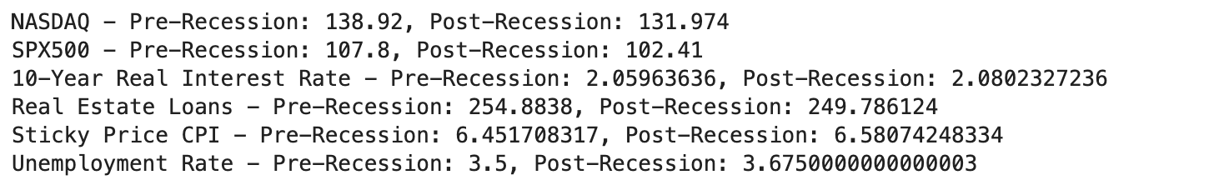
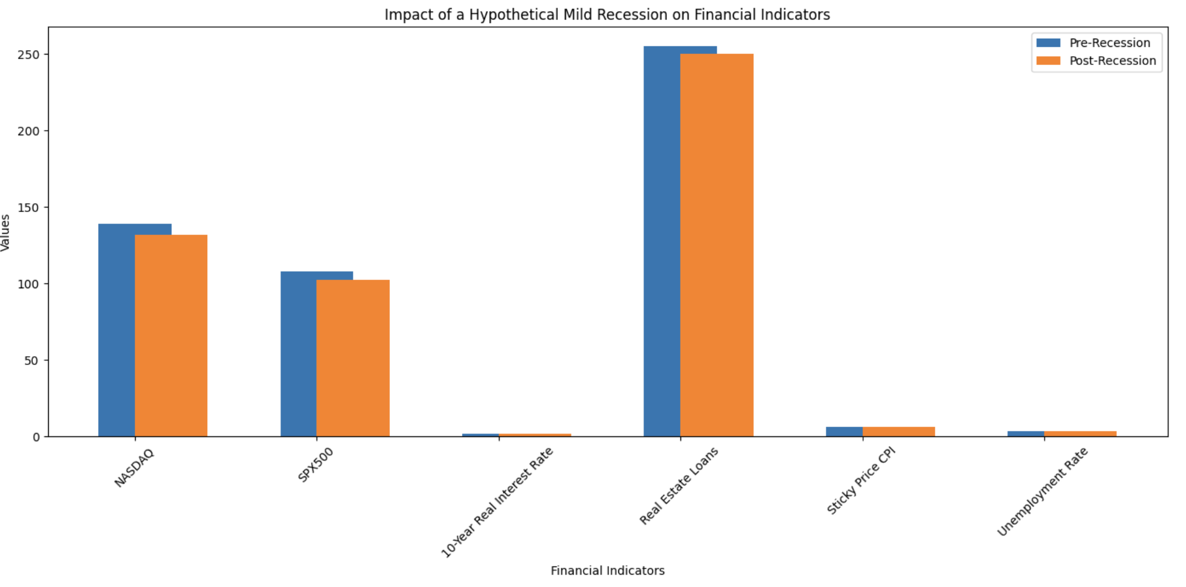
Recession Impact Analysis

Slide 14

Predictive Analysis & Conclusion
The ARIMA models yield nuanced forecasts that, when juxtaposed with the projected effects of a mild recession, reveal potential shifts in crucial financial indicators.
Our analysis simulates a recession's impact, indicating potential contractions in market indices, adjustments in interest rates, and variations in unemployment and consumer prices.
These projections underscore the significance of foresight in economic planning. The ability to anticipate and prepare for these changes is invaluable for policymakers, investors, and businesses alike.
Our study reaffirms the potency of predictive models in financial data science and the paramount importance of strategic agility in an ever-dynamic economic landscape.

Slide 15

References
"US Recession and Financial Indicators". A comprehensive dataset that provided the financial data for our ARIMA modeling. Available at: Kaggle Dataset
Explores time series analysis concepts within the financial domain. Available at: Time Series Analysis (Class 9 Notebook)
Discusses Moving Average and Autoregressive models using stock price data. Available at: Time Series Analysis-2 (Class 10 Notebook)
A look into the metrics used to measure the performance of time series models. Available at: Time Series Analysis (Class 9 & 10 Notebooks)

Slide 16

THANK YOU

